Slide 1

How population age correlates to distance from a major city center
Miguel Gomes | Abdallah Holozadah | Sarah Steimle
September 18, 2018

Slide 2
Outline
Hypothesis
Experiment
Results

Slide 3
Hypothesis
As you move radially from a major city center, the median population age will increase.

Slide 4
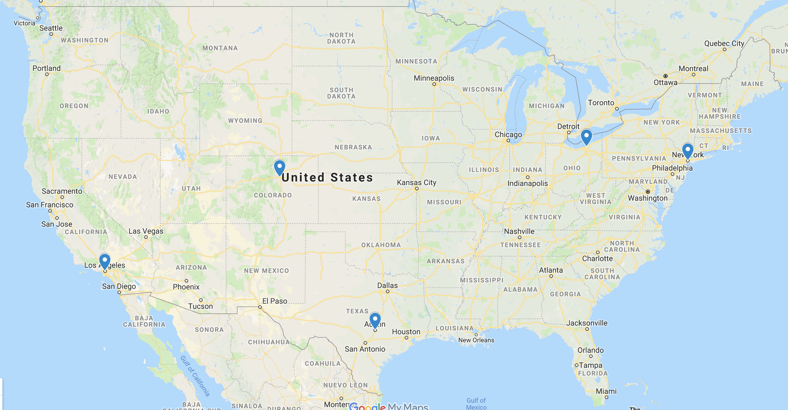
What cities did we look at
We chose “major cities” (population > 500k)
We chose cities across different regions
And we chose 4 different radii – 5, 10, 15, 20 miles
Cleveland
Denver
New York
Los Angeles
Austin

Slide 5
What we thought it would be
Zip Code API to determine zip codes within a radius of the city
Zip Code to mean age mapping
Mean age by distance from city center

Slide 6
What it really was
Zip Code API to determine zip codes within a radius of the city ^{[1]}
Zip Code to ZCTA* mapping ^{[2]}
Median age by distance from city center
ZCTA to median age mapping ^{[3]}
*ZCTA = Zip Code Tabulation Area
https://www.policymap.com/2016/03/what-are-zip-code-tabulation-areas/
https://www.zipcodeapi.com/API
https://www.udsmapper.org/zcta-crosswalk.cfm
https://factfinder.census.gov/faces/nav/jsf/pages/index.xhtml

Slide 7
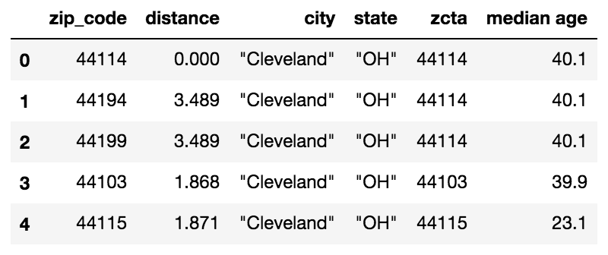
We have data!
Now to answer some questions…

Slide 9
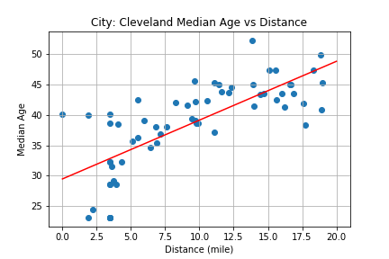
Our initial analysis
City | R-squared
Cleveland | 0.508
Denver | 0.084
NYC | 0.057
LA | 0.013
Austin | 0.080
We assumed a linear relationship between distance (radius) from the city center and the median population age.
The linear regression shows us... we don’t have one!

Slide 10
Where do we go from here?
Our hypothesis isn’t invalidated, yet.
With the exception of Cleveland, the other cities do not show a strong enough linear relationship to support our original assumption.
So what does ANOVA tell us?

Slide 11
ANOVA
City | P-Values Constant Distance
Cleveland | 0.000 | 0.000
Denver | 0.000 | 0.001
NYC | 0.000 | 0.000
LA | 0.000 | 0.024
Austin | 0.000 | 0.007
With 95% confidence, we can state that there is a statistically significant difference in the median population as you move across the different radii.

Slide 12
Conclusions
We believe our analysis supports our hypothesis!
Although the R-squared values are too weak to support a strong linear relationship, each dataset does show an increase in median population age as you move from the city center

Slide 13
Future exploration
Why does Cleveland have a much higher R-squared value compared to the other cities?
How do smaller cities (Cleveland, Pittsburgh) compare to larger cities (Houston, NYC) in their population vs. distance relationship?
What are the other factors affecting the age v. distance relationship – income, education, job market?

Slide 14
Questions?

